Slide 1
Build distribution

Slide 2
Apple member center
Bundle id
Certificates
Devices
PROVISION PROFILE

Slide 3
certificates
DEVELOPMENT
PRODuction

Slide 4
Provision profiles
Ad hoc
Appstore
development

Slide 5
XCode
Automatic
By hands

Slide 6
itunesconnect
Create application
Bundle id
Name
Language

Slide 7
Distributing build
select signing data
Archive
Export or upload to appstore
Select team
Start

Slide 8
Submission process
Fill necessary data
Add application screens
Select build
Add application icon
Add description

Slide 9
Testers/customer distribution tools
Fabric
Testflight
Link(diawi)

Slide 10
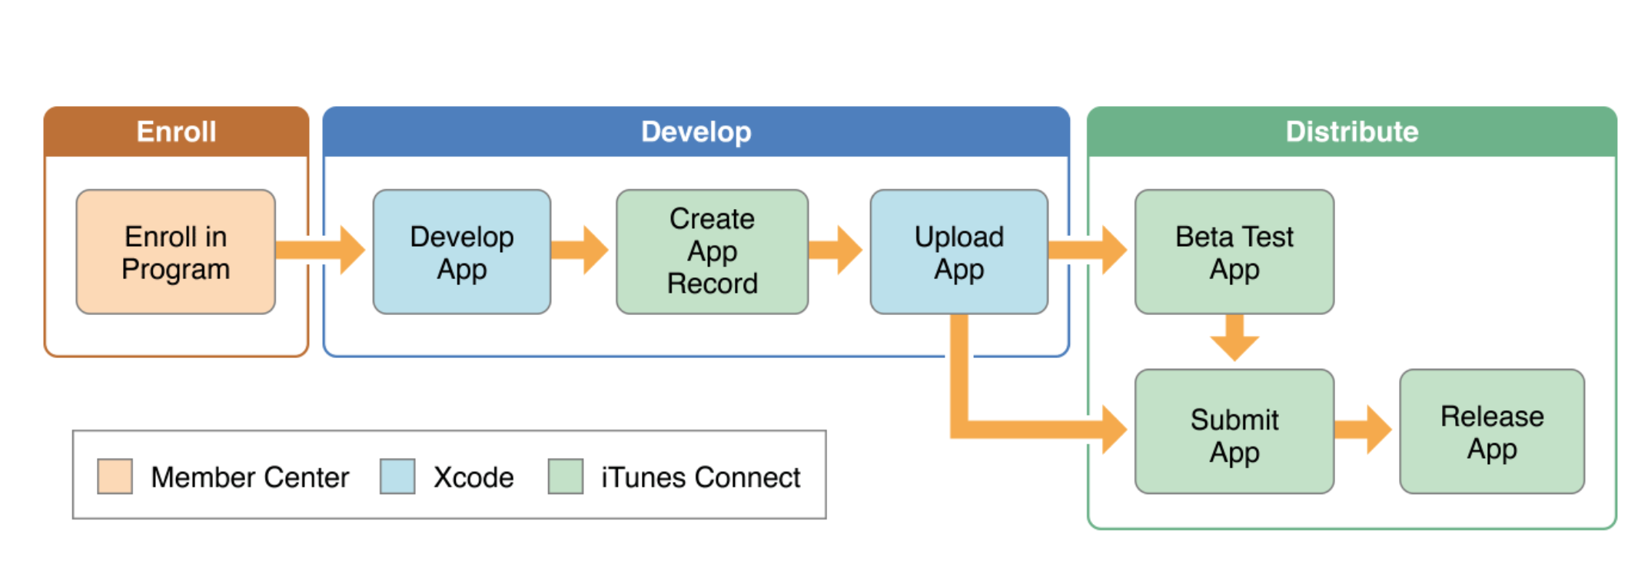
process

